Slide 1
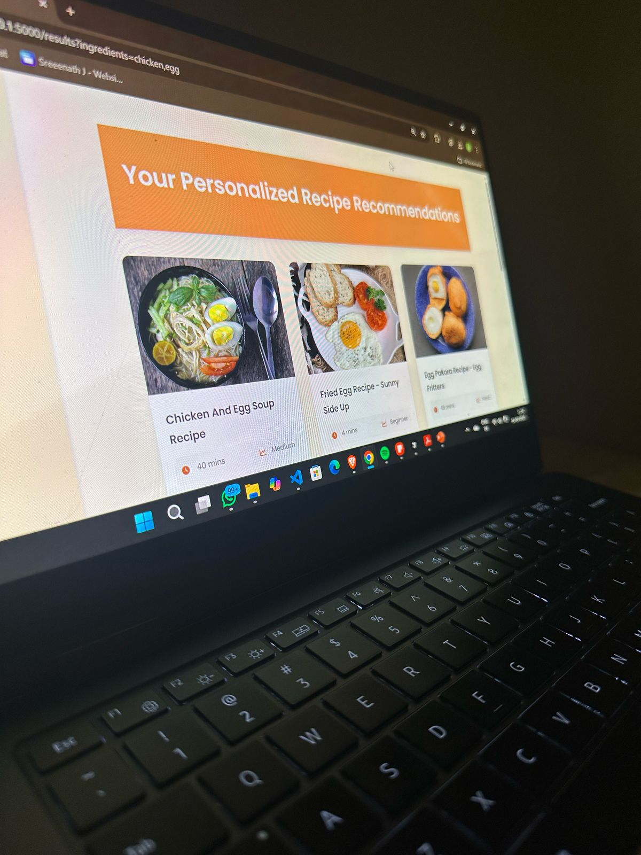
Foodie Finder: Overview and Purpose
Foodie Finder is a Flask-based web application that helps users discover recipes using their available ingredients. Built with Machine-Learning, it leverages Flask, SQLAlchemy, scikit-learn, and NLTK for its functionality. The Web-app solves the problem of finding meal ideas with what you already have.

Slide 2

Foodie Finder:Technologies Used
Backend:Flask, Werkzeug,Flask-Login,Flask-SQLAlchemy
nlkt,scipy, Numpy,Pandas, Scikit-learn
Frontend: HTML,CSS,Javascript
Database: SQLAlchemy,alembic
Libraries:
Numpy,Pandas
Scikit-learn,
re,ast,nltk,pickle,os
Version Control: Git and Github
CI/CD Tools: Github Actions for testing
Enhanced UI/UX: Improve the user interface and overall experience of using the application.

Slide 3
Foodie Finder: Powerful Features
• Smart Ingredient Matching: Uses TF-IDF and cosine similarity to find recipes based on available ingredients and it ignores irrelevant ingredient queries by the usage of threshold and separate ingredient query processing
• Cooking Time Filters: All(All durations), Quick (0-30 min), Medium (30-60 min) and Long (60+ min) options
• User Authentication: Secure login/signup system with password hashing and session management
• Favorites System: Save and manage your favorite recipes with add to favourites and remove from favourites functionalities
• User Profiles: Personalized user profile page
• Responsive Design: Modern UI that looks professsional
• Recipe Details: View comprehensive recipe information including ingredients, instructions, cooking time and nutritional info. Print recipe function

Slide 4

Challenges Faced, Integration of CI/CD& tests written
ML Model Integration: When we tried to on only ingredients it gave random results because we generally type the most important ingredients in input, since the recipe name generally contains most important ingredients , we used feature engineering and gave more importance to recipe name and we used a threshold in cosine similarity to restrict irrelevant results
Database Management: Setting up relational databases on is a challenge.
NLTK Dependency Management: Ensuring NLTK data is consistent for test runs.
Tests Written: There are 4 test files
conftest.py: Shared fixtures and setup
test_routes.py: test route functionality
test_auth.py: tests user authentication
test_recipe_search.py: tests recommendations
Library used for testing: Pytest
Integration of CI/CD: Slow pipelines and managing and man

Slide 5

Future Improvements:
Give tailored suggestions based on user favourites and user ratings
Give recommendations based on locality of user
Include multiple worldwide cusines
Include Password security
Introduce Meal planning, shopping list
Integrate AI-recommendations
Include multi-lingual support

